Slide 1

Data Science Project on Stock Market Using LSTM
In this presentation, we will walk you through a data science project on the stock market using LSTM (Long Short-Term Memory) models. Get ready to dive into the world of finance and machine learning!
Submitted by –Azim Khan
Krishna Nayak
Rugved Chaudhari
Neeraj Kumar M.N
Sinduja T
Tarun Bachagari

Slide 2
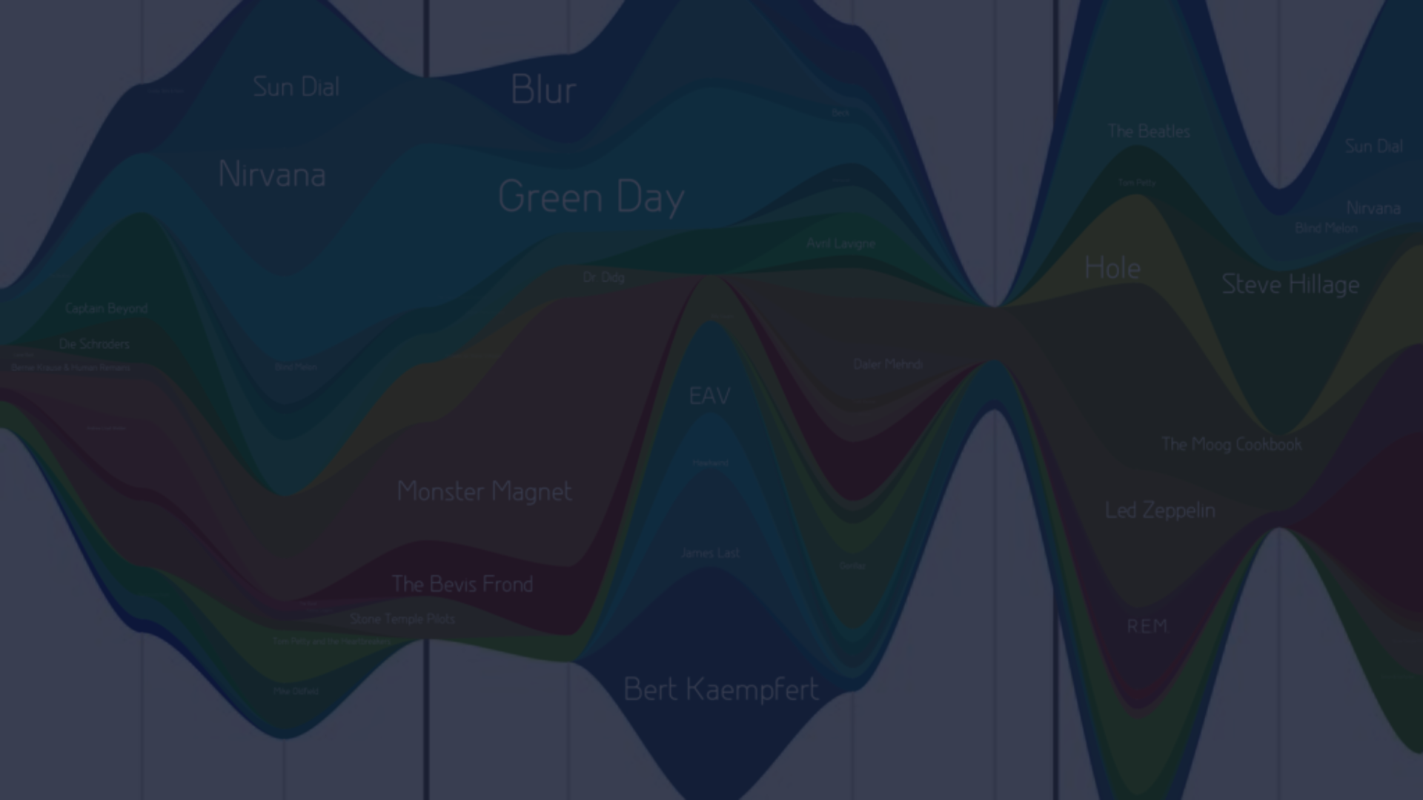
Introduction
Here we will learn about the importance data science in stock market , its future importance .
With the problem statement , and the contents which we are going to discuss in further slides.

Slide 3
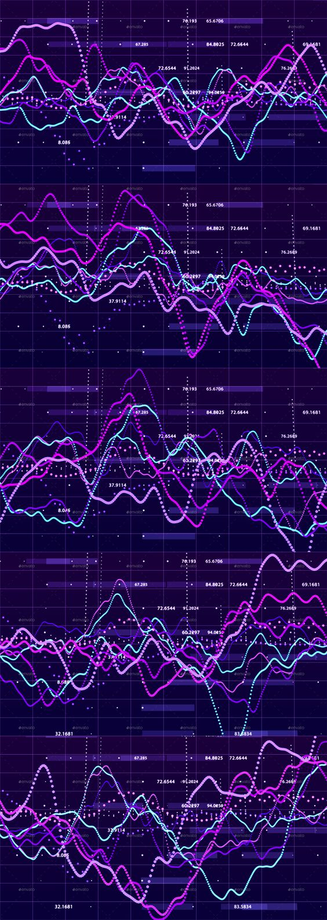

Role Of Data Science In Stock Market
Data science has transformed our economy. The best example of data science is the disruption it had on the Indian stock market. As one of the major segments of a country’s economy, the stock market has used this digital revolution to go from strength to strength.
From analyzing market trends and predicting stock prices to identifying potential trading opportunities in the stock market.
Data science provides invaluable financial business intelligence.
This method uses past data to predict future market patterns, stock prices, and earnings. To assist investors in wise investment decisions, investors can utilize predictive analytics to spot patterns and trends in the stock market.

Slide 4
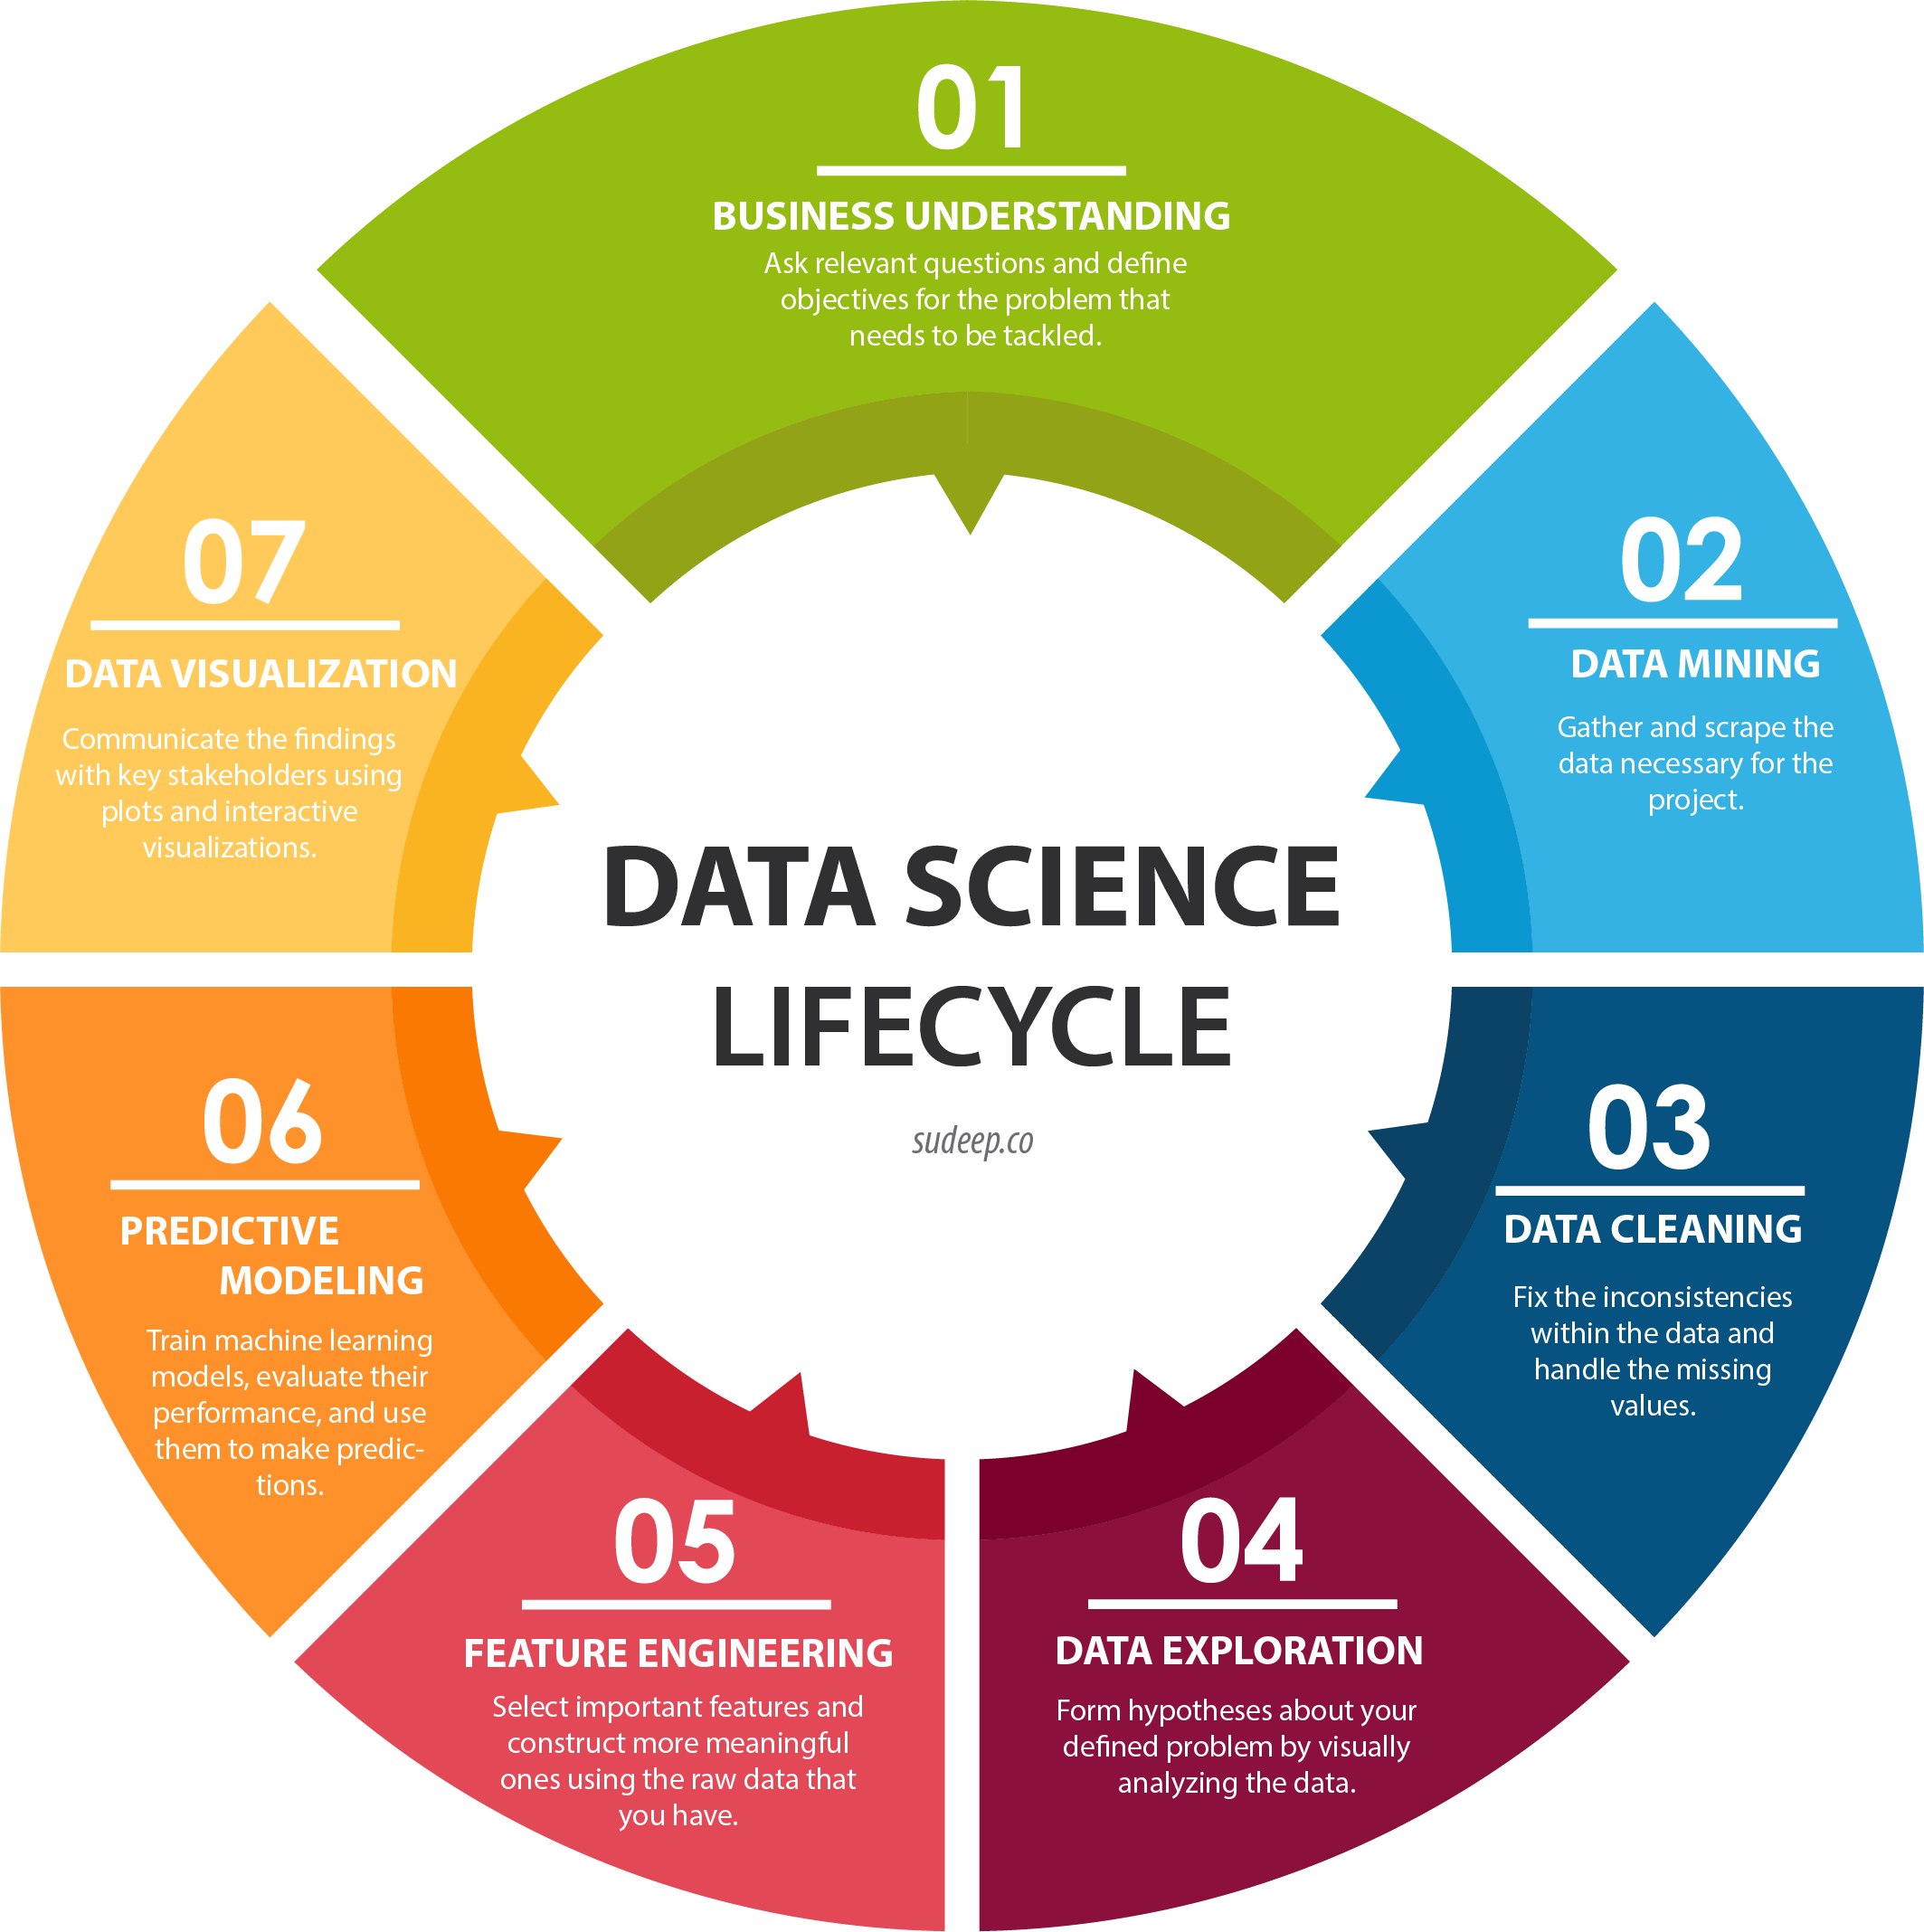
Understanding the Data Science Lifecycle

Slide 5
Steps in Time Series Data Projects
1
Data Collection and Preprocessing
( Gather relevant time series data and apply preprocessing techniques to prepare it for analysis.)
Exploratory Data Analysis
2
( Uncover patterns, trends, and correlations within the time series data to gain insights.)
3
Model Selection and Training
( Select appropriate time series models and train them on the data to make predictions or forecasts.)
Model Evaluation
4
( Assess the performance of the trained models and validate their accuracy and reliability.)
5
Model Deployment

Slide 6
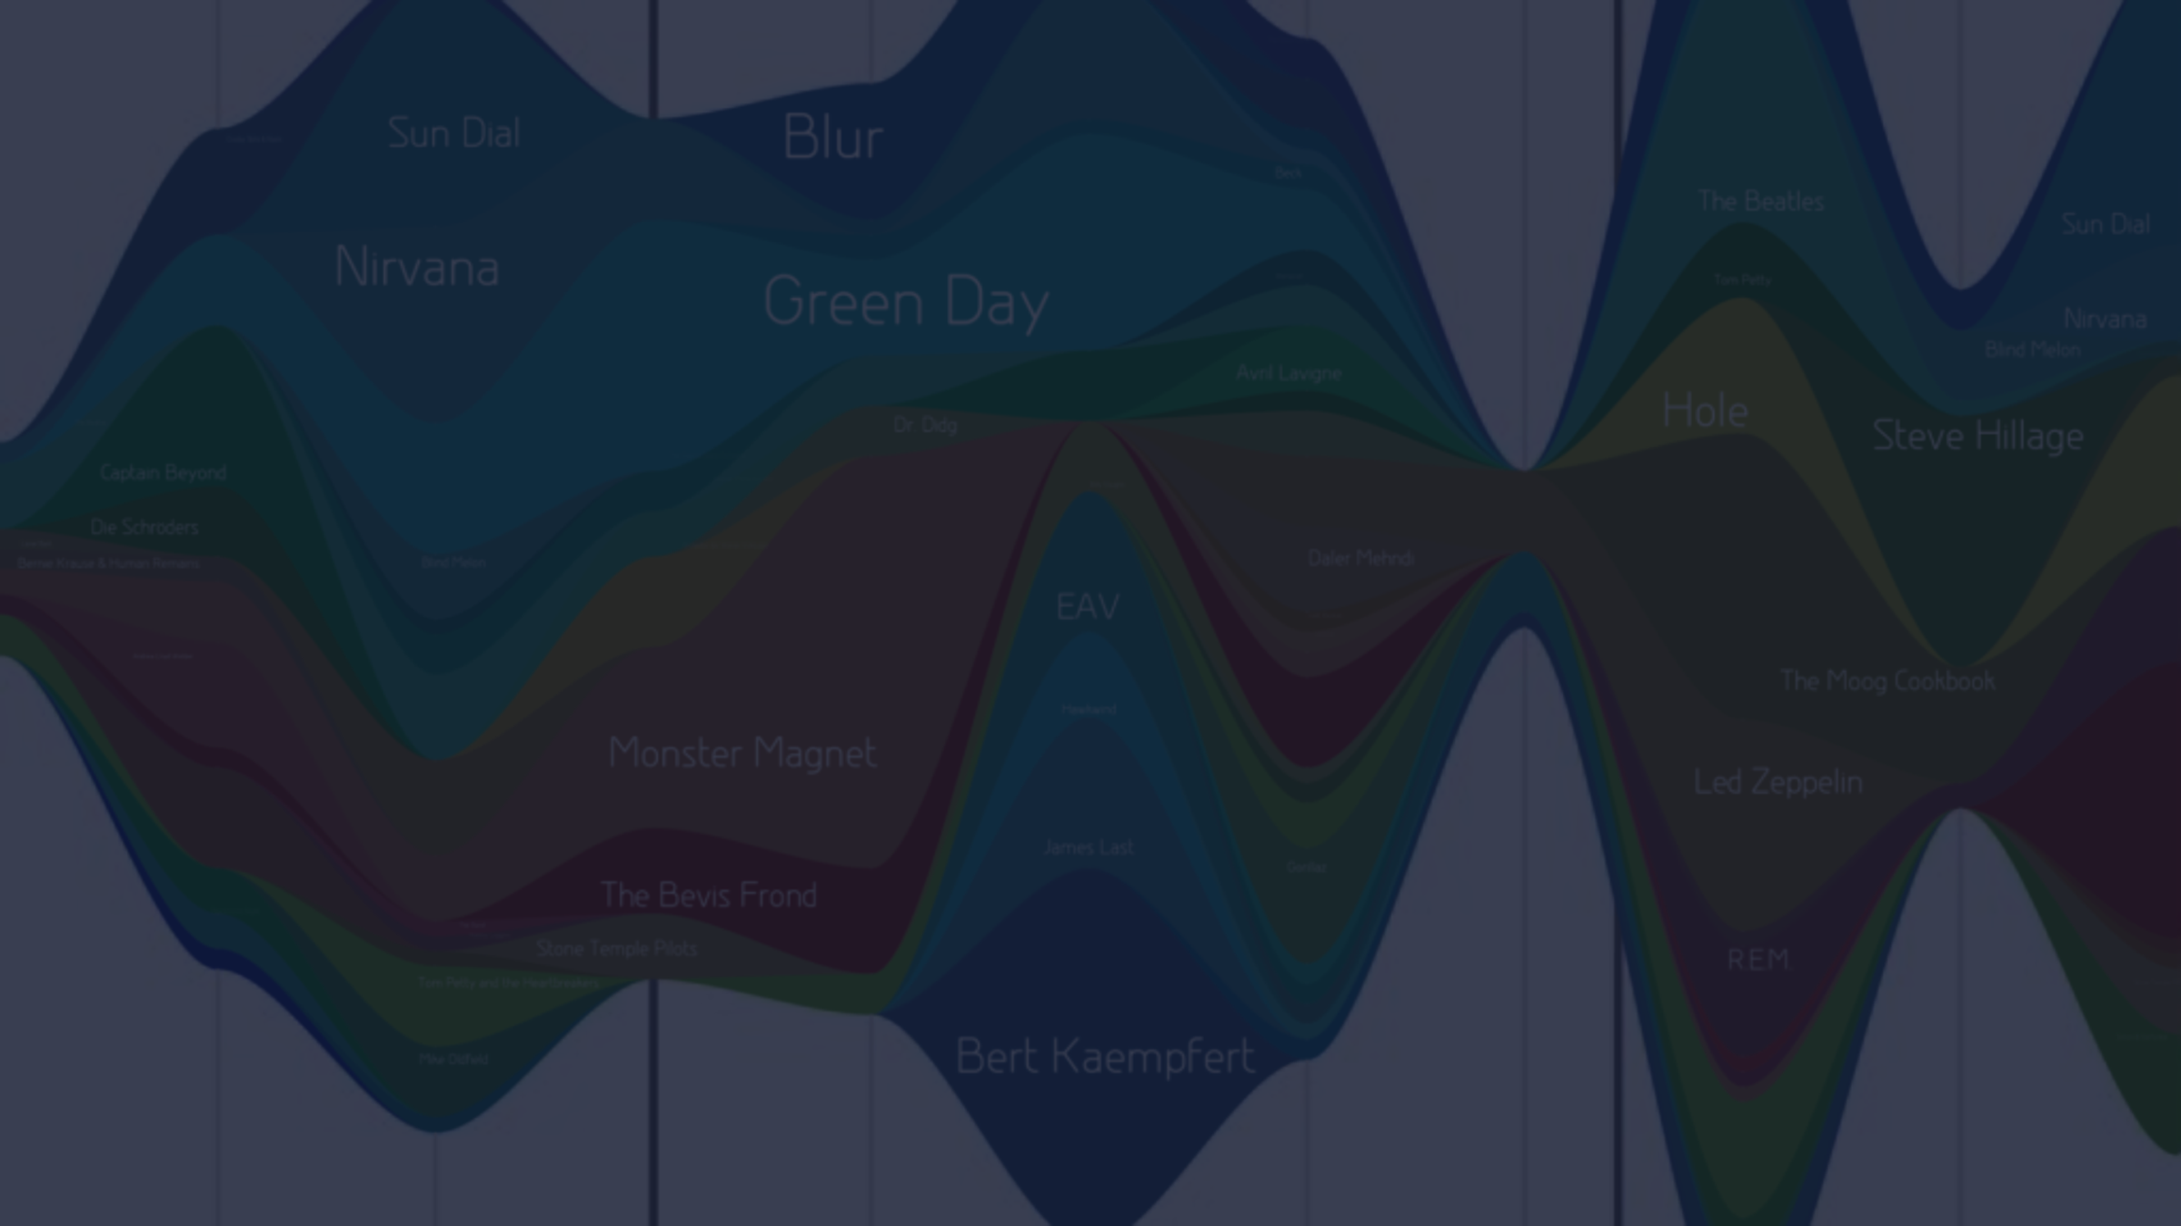
Data Collection and Preprocessing
Before training our LSTM model, we need to preprocess and prepare the stock market data. From handling missing values to normalizing the data, we will cover the necessary steps to ensure accurate predictions.

Slide 7

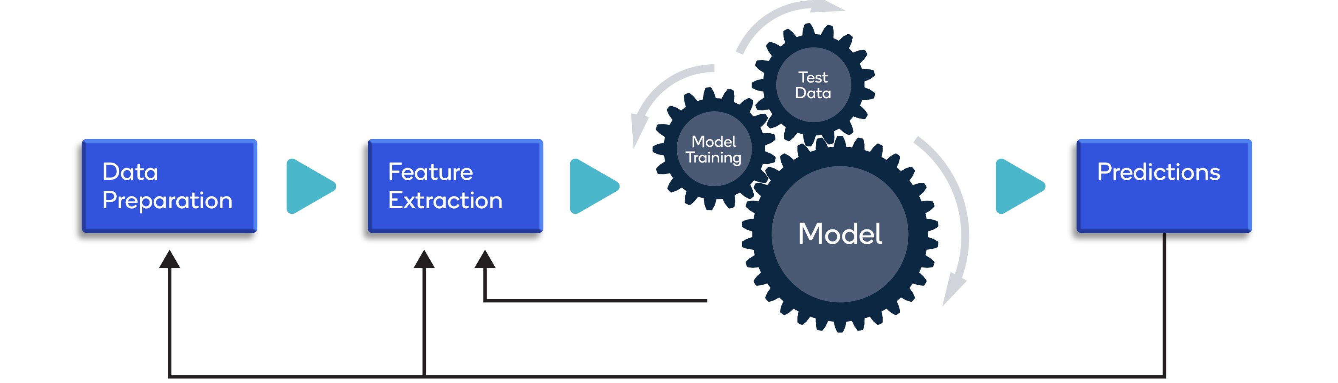
Data collection
Collecting data for training the ML model is the basic step in the machine learning pipeline. The predictions made by ML systems can only be as good as the data on which they have been trained. Following are some of the problems that can arise in data collection:
Inaccurate data. The collected data could be unrelated to the problem statement.
Missing data. Sub-data could be missing. That could take the form of empty values in columns or missing images for some class of prediction.
Data imbalance. Some classes or categories in the data may have a disproportionately high or low number of corresponding samples. As a result, they risk being under-represented in the model.
Data bias. Depending on how the data, subjects and labels themselves are chosen, the model could propagate inherent biases on gender, politics, age or region, for example. Data bias is difficult to detect and remove.
Data pre-processing
Real-world raw data and images are often incomplete, inconsistent and lacking in certain behaviors or trends. They are also likely to contain many errors. So, once collected, they are pre-processed into a format the machine learning algorithm can use for the model.

Slide 8

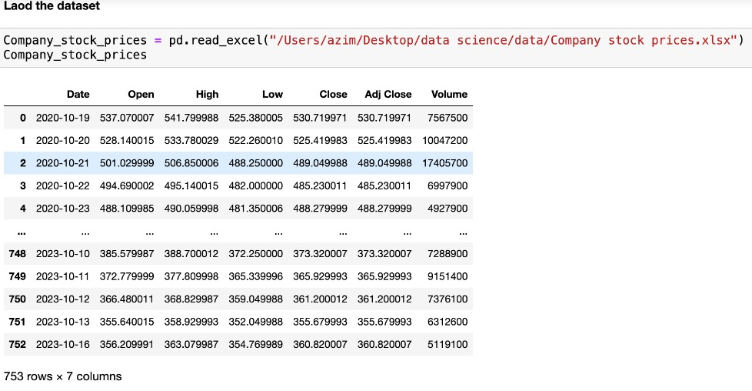

Slide 9
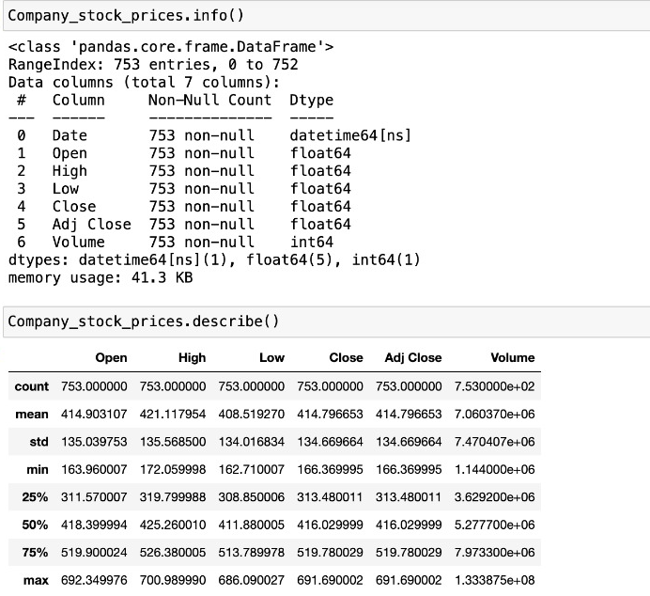
Data is checked , and there is no null value present in the dataset . Also, we got to know the datatype of the columns .
We performed all the statistics , we got to know the main values of mean, standard deviation , min-max.

Slide 10
Exploratory Data Analysis
A picture is worth a thousand words. We will leverage the power of visualizations to gain valuable insights from the stock market data. Prepare to explore captivating charts and interactive plots!

Slide 11
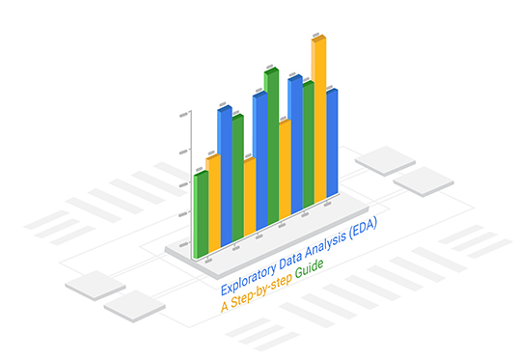
Why is exploratory data analysis important in data science?
The main purpose of EDA is to help look at data before making any assumptions. It can help identify obvious errors, as well as better understand patterns within the data, detect outliers or anomalous events, find interesting relations among the variables.
Data scientists can use exploratory analysis to ensure the results they produce are valid and applicable to any desired business outcomes and goals.
EDA also helps stakeholders by confirming they are asking the right questions.
EDA can help answer questions about standard deviations, categorical variables, and confidence intervals.
Once EDA is complete and insights are drawn, its features can then be used for more sophisticated data analysis or modeling, including machine learning.

Slide 12
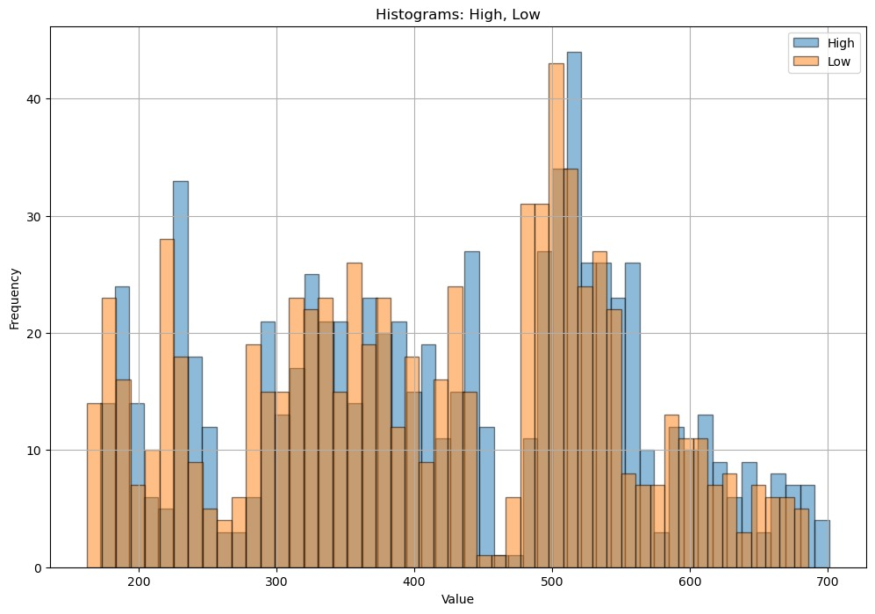
The histograms for 'High' and 'Low' prices show the distribution of daily high and low prices. Both histograms have long tails on the right side, it indicating that there are occasional extreme price values.

Slide 13
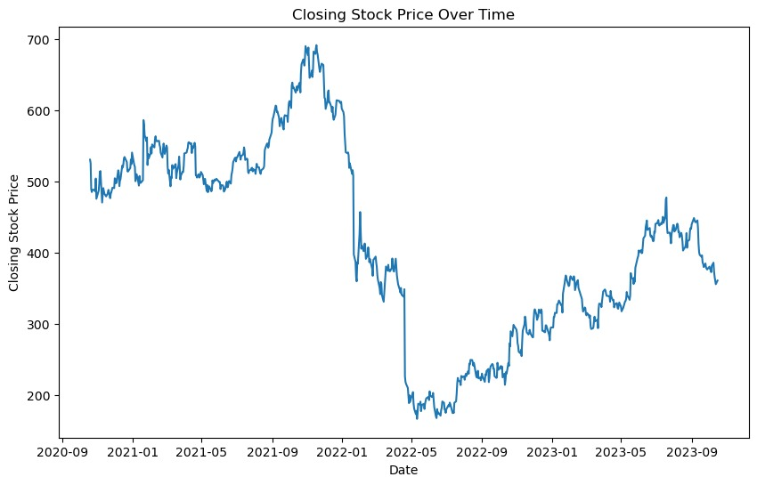
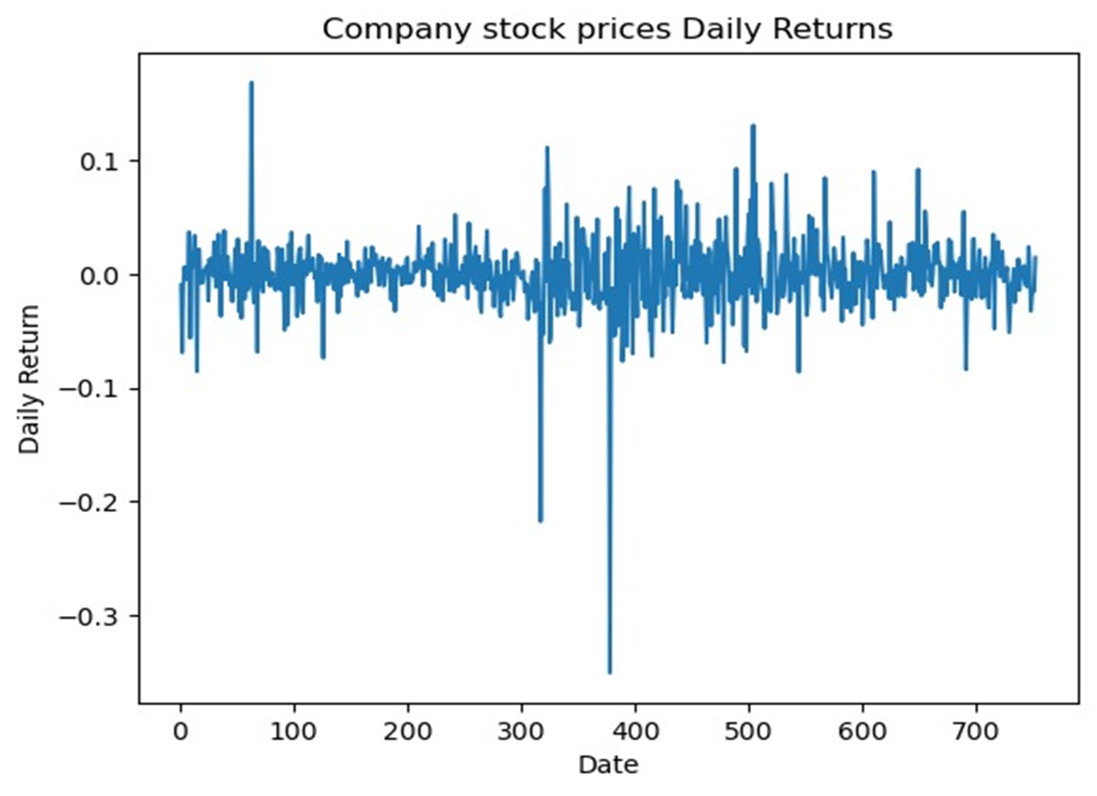
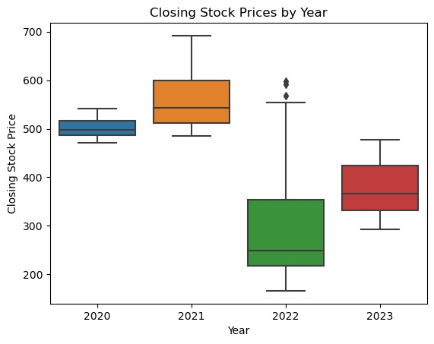
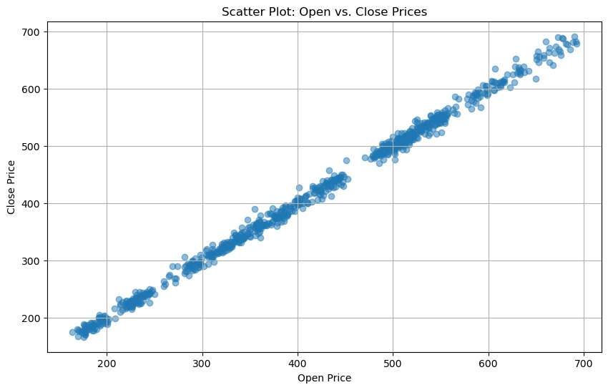

Slide 14
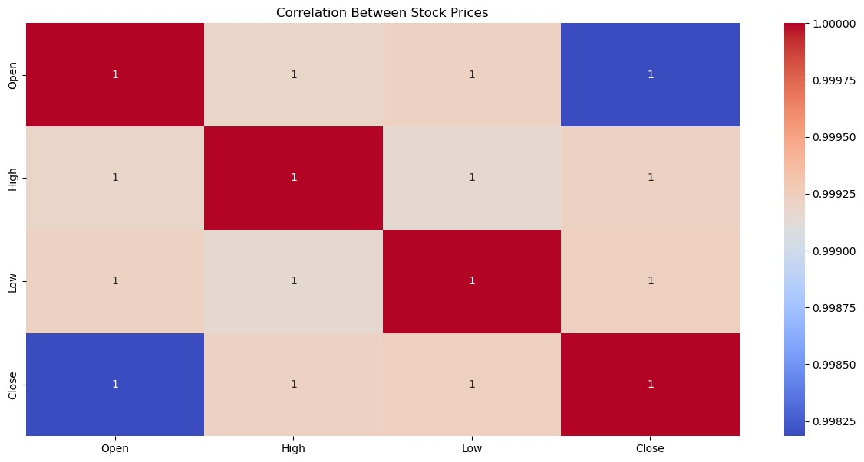
From the heatmap, we can see that the opening and closing prices have a strong positive correlation, while the low and high prices have a weaker positive correlation.
We can start by visualizing the distribution of the target variable, which in this case is the closing stock price. We can use a histogram to visualize the distribution.

Slide 15
Model Building
Model building is an essential part of data analytics and is used to extract insights and knowledge from the data to make business decisions and strategies. In this phase of the project data science team needs to develop data sets for training, testing, and production purposes.

Slide 16

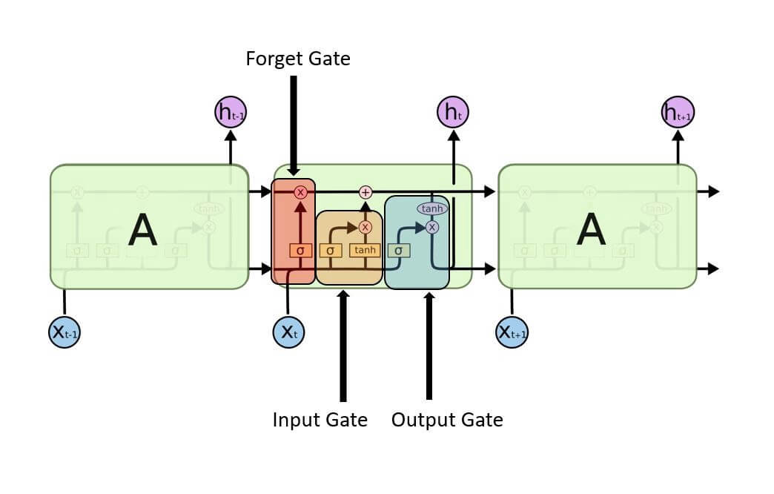
What is LSTM?
Long Short-Term Memory is a recurrent neural network (RNN) architecture widely used in Deep Learning. It excels at capturing long-term dependencies, making it ideal for sequence prediction tasks.
Unlike traditional neural networks, LSTM incorporates feedback connections, allowing it to process entire sequences of data, not just individual data points. This makes it highly effective in understanding and predicting patterns in sequential data like time series, text, and speech.
LSTM has become a powerful tool in artificial intelligence and deep learning, enabling breakthroughs in various fields by uncovering valuable insights from sequential data.

Slide 17
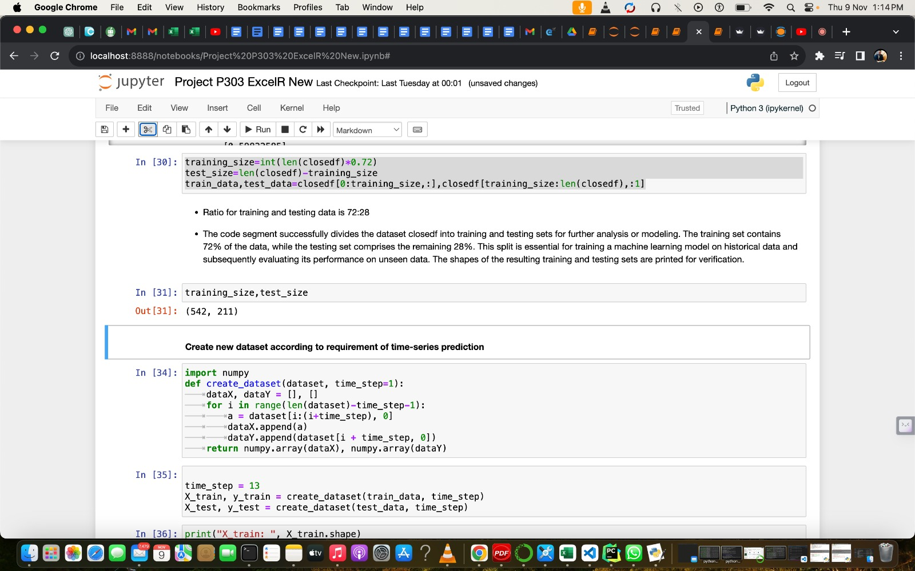

Slide 18
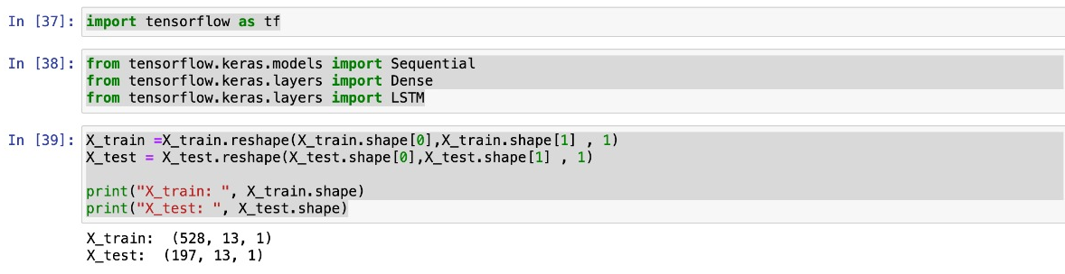
This code is preparing the data for a time series prediction task, possibly for a neural network model, with 528 samples in the training set, each having 13time steps and 1 feature per time step. Similarly, there are 197 samples in the test set with the same time step and feature configurations.

Slide 19
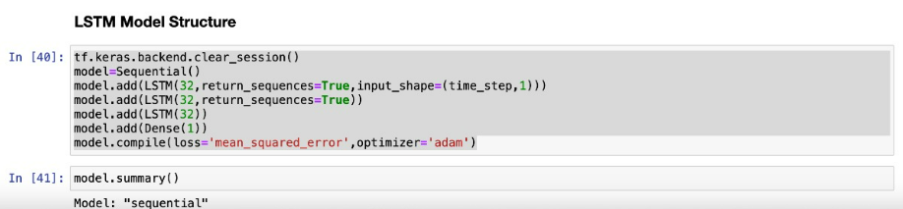
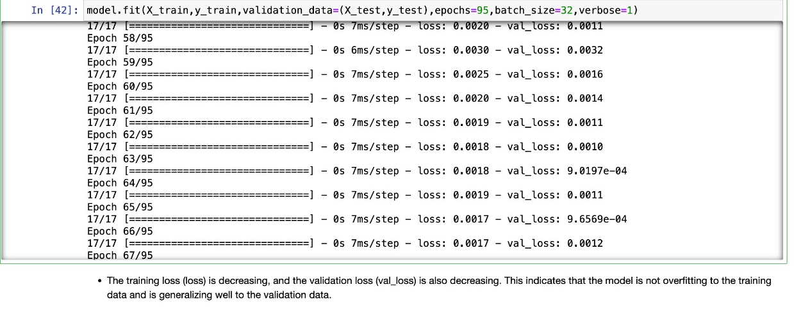

Slide 20
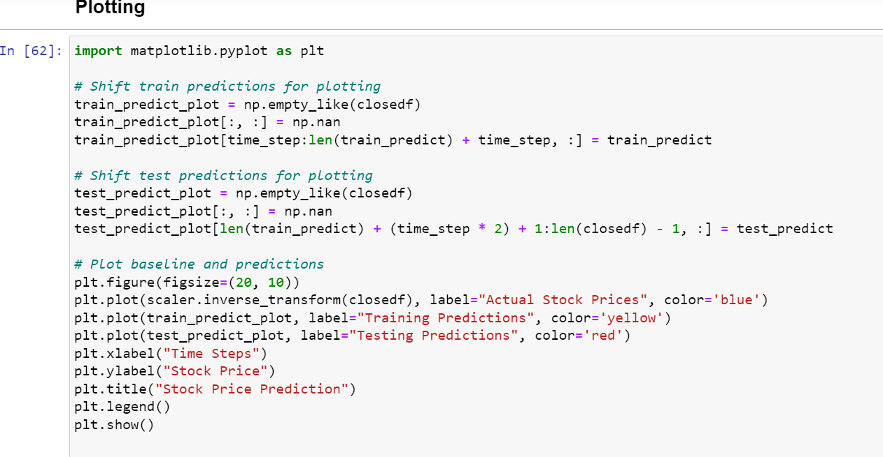
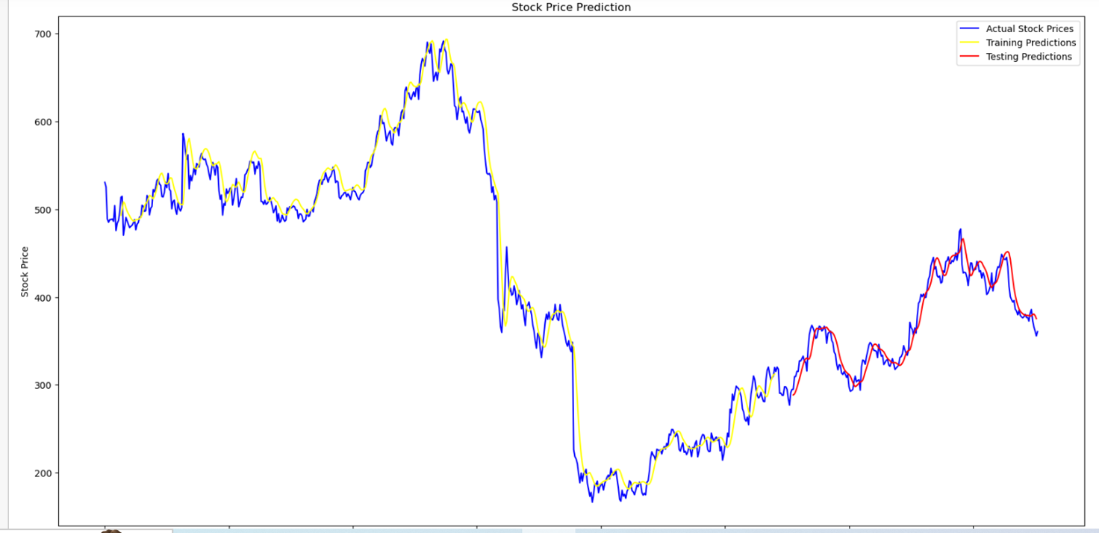
Stock price Prediction

Slide 21
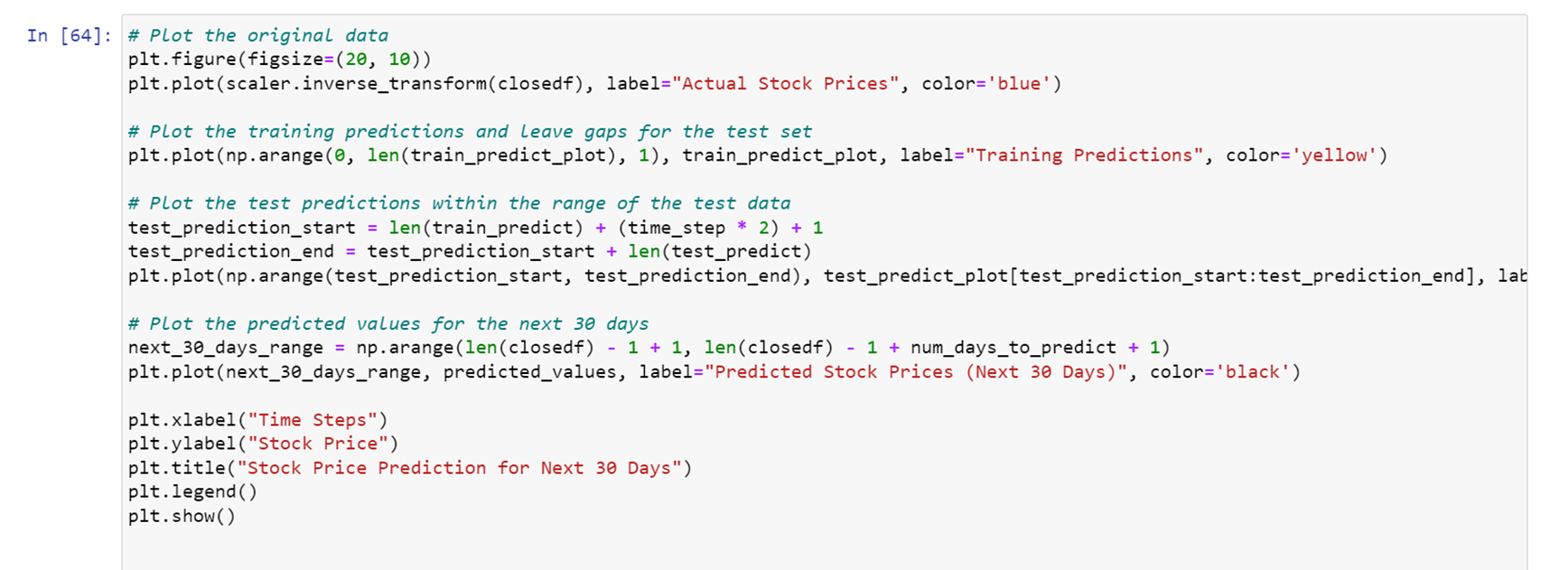
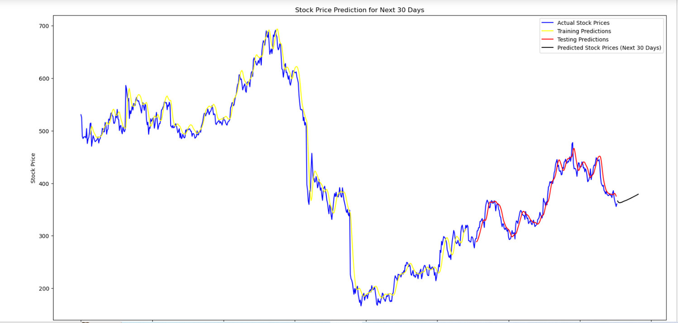
Stock price Prediction for Next 30 Days

Slide 22
Model Deployment
Model Deploying a machine learning model, known as model deployment, simply means to integrate a machine learning model and integrate it into an existing production environment (1) where it can take in an input and return an output.

Slide 23
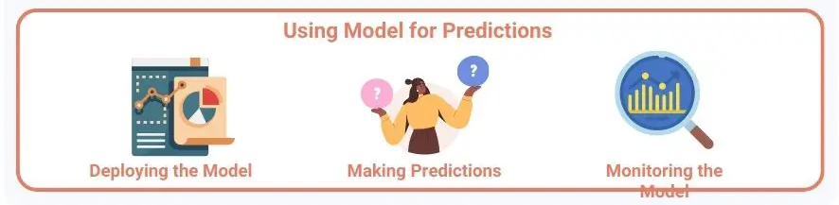

Model deployment in machine learning is a critical step that involves taking a trained machine-learning model and making it accessible for real-world applications. This process is necessary to leverage the model's predictive capabilities and automate decision-making.
Deployment enables businesses to integrate the model into their systems, processing new data and generating predictions in real-time. Whether in recommendation systems, fraud detection, or autonomous vehicles, model deployment ensures that the insights and patterns learned during training can be put to practical use, benefiting various industries and solving a wide range of complex problems.
It's the bridge that connects the world of data science with real-world impact.

Slide 24
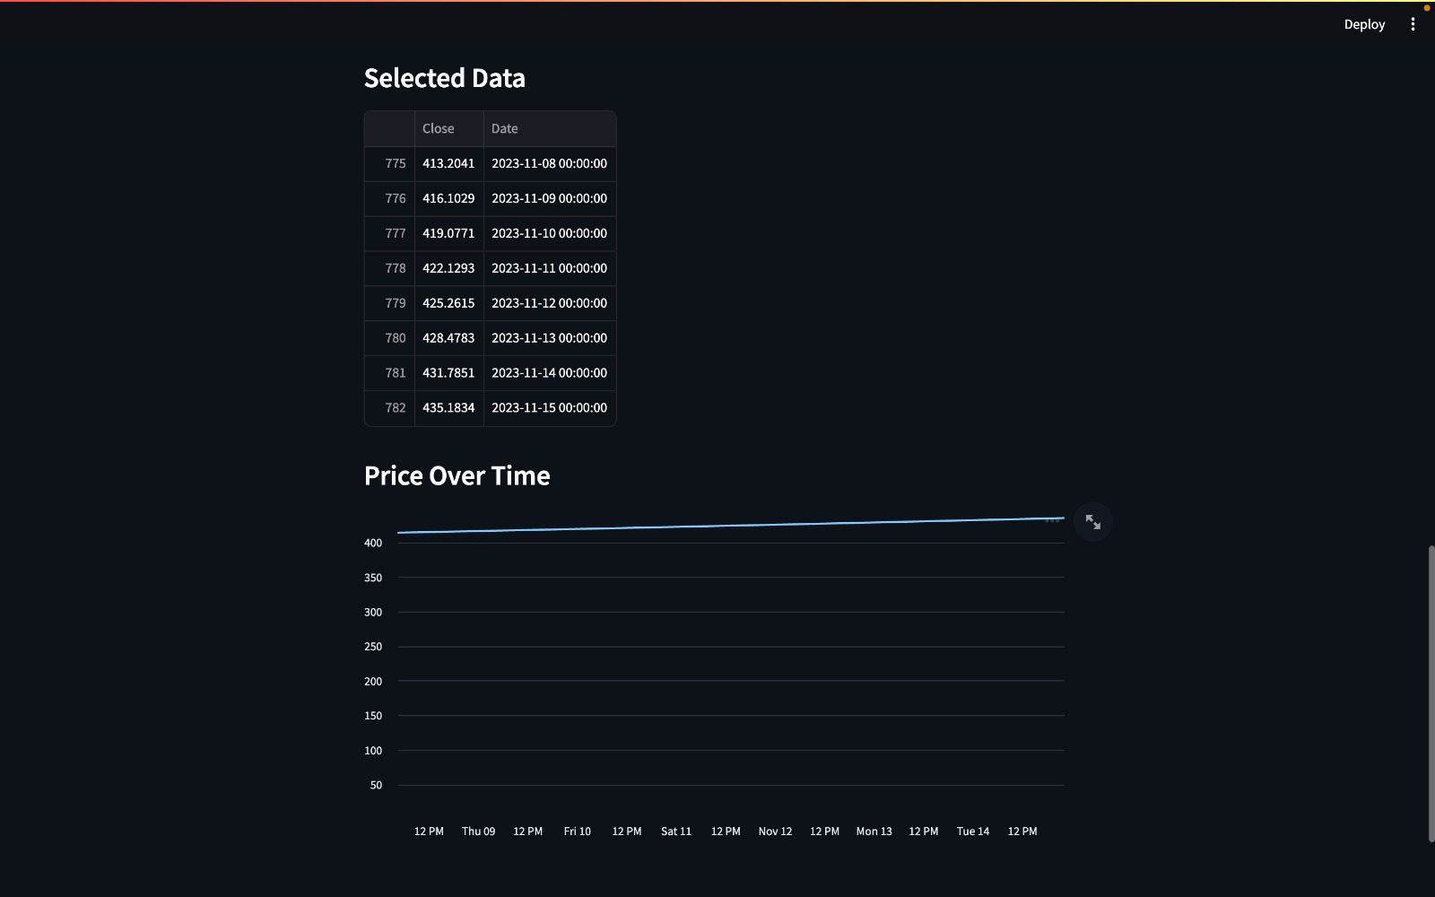
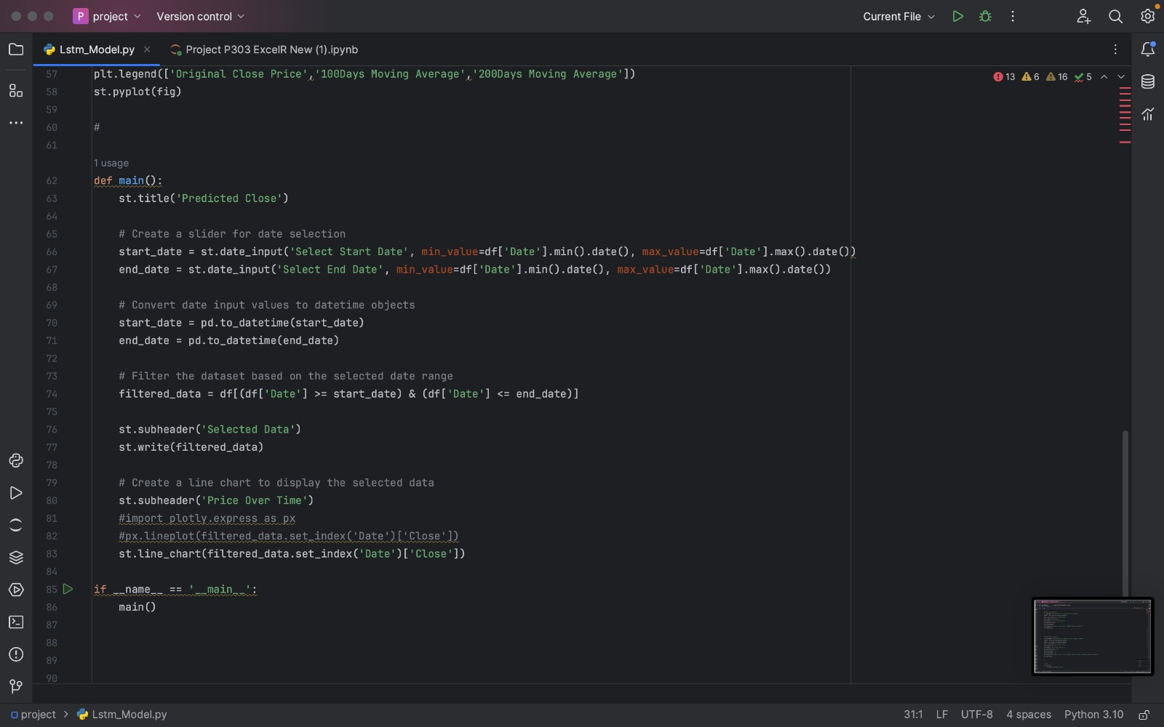

Slide 25
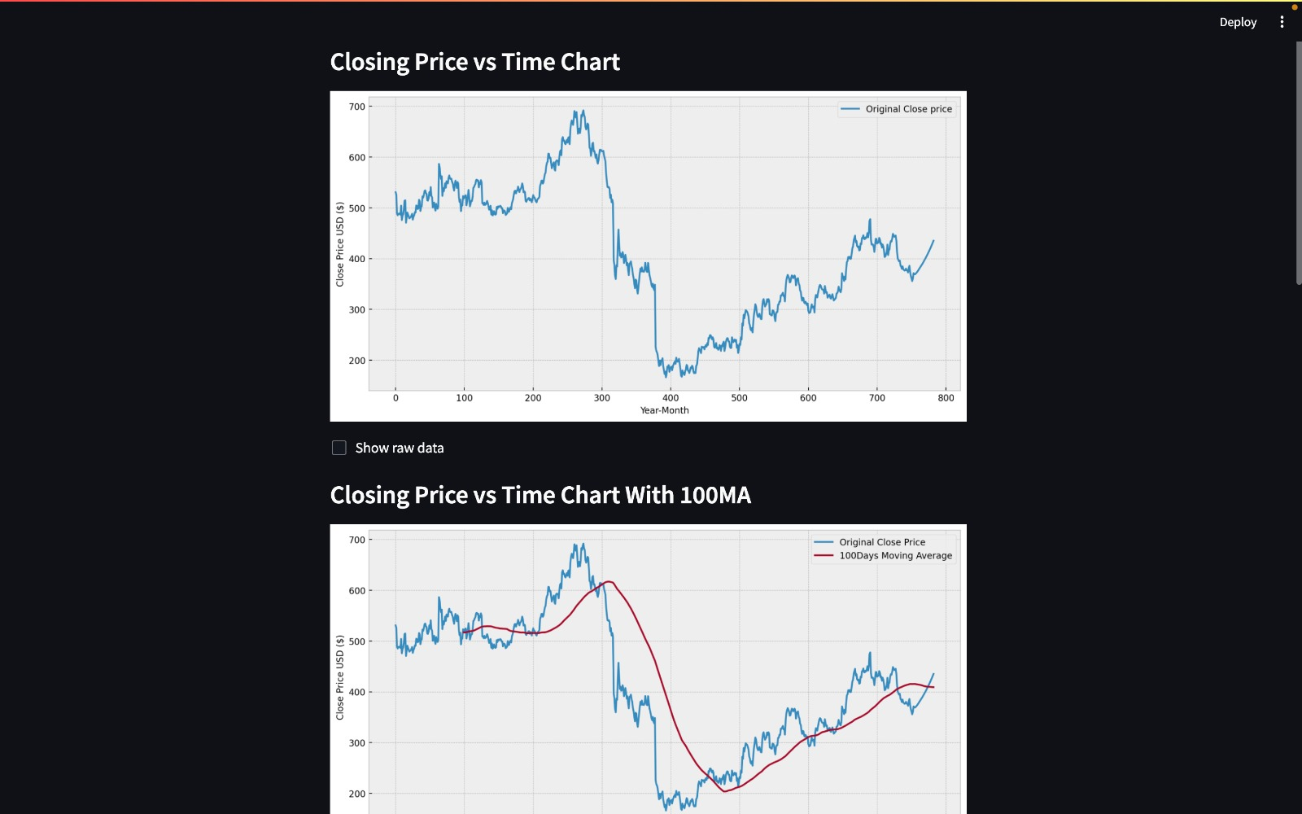
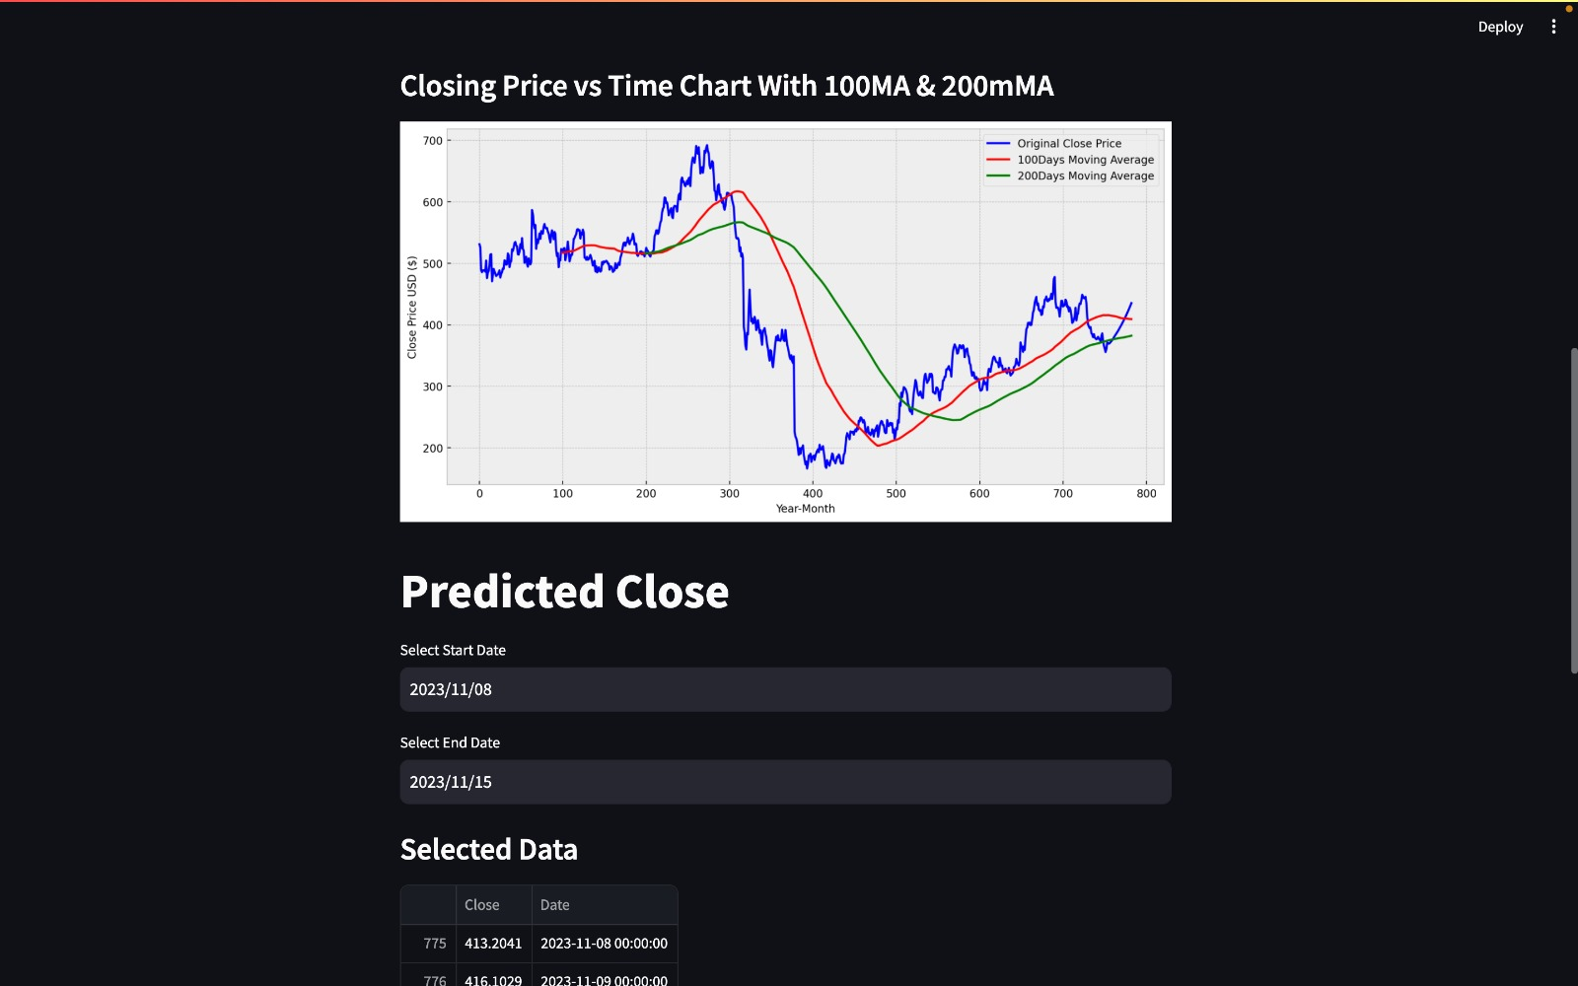

Slide 26
Conclusion
"In conclusion, the analysis of the time series dataset of closing stock prices has provided valuable insights into the historical performance of the stock. We observed trends, seasonality, and fluctuations over time. Key findings include Future price predictions . These insights can be used to make informed investment decisions, develop trading strategies, and forecast potential future stock price movements. It's important to note that while historical data can provide valuable guidance, it should be used in conjunction with other factors and analysis for making investment decisions.".

Slide 27

Thank you!

